Slide 1
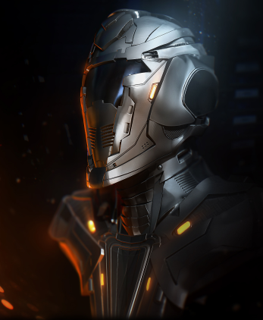
Domination duel
A card game by Project Group 5
Pim van Zomeren
Razvan Preda
Jet Frieling
Sebastiano Mirabella
Marcel Stoepkers

Slide 2
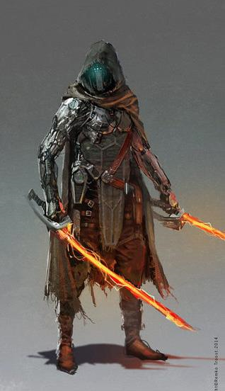
Brief Summary
Duel based card game
Sci-fi setting with medieval influences
Activating character cards, and use them to attack the opponent’s defense
Using special cards (which cost recources) with the role of effects and spells, to gain the upper hand
Random occurences and luck-based system, combined with strategy

Slide 3
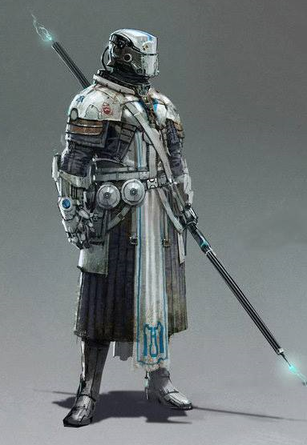
Unique Selling Points
Immersive gameplay due to having Health Points as a player, aswell as having ‘soldiers’
Unique theme by combining Sci-Fi, Medieval and other themes
System for random occurences and the element of suprise, adding up to the realism of the game
The game would be buyable as one package, including the board, two decks and special cards.

Slide 4
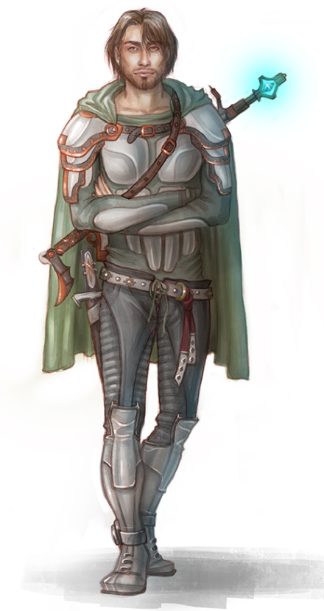
Development Process
Coming up with a unique theme and style
Thinking of ways to make the game realistic, by having strategy combined with random events
Making a system to collect resources and use those resources to your advantage
Balancing the game, in terms of: number of cards, health, resources

